Slide 1
Jonah 2:10 – 4:4 (NIV)
10And the Lord commanded the fish, and it vomited Jonah onto dry land.
3:1Then the word of the Lord came to Jonah a second time: 2 "Go to the great city of Nineveh and proclaim to it the message I give you." 3 Jonah obeyed the word of the Lord and went to Nineveh. Now Nineveh was a very important city-a visit required three days. 4 On the first day, Jonah started into the city. He proclaimed: "Forty more days and Nineveh will be overturned." 5 The Ninevites believed God. They declared a fast, and all of them, from the greatest to the least, put on sackcloth.

Slide 2
Jonah 2:10 – 4:4 (NIV)
6 When the news reached the king of Nineveh, he rose from his throne, took off his royal robes, covered himself with sackcloth and sat down in the dust. 7 Then he issued a proclamation in Nineveh: "By the decree of the king and his nobles: Do not let any man or beast, herd or flock, taste anything; do not let them eat or drink. 8 But let man and beast be covered with sackcloth. Let everyone call urgently on God. Let them give up their evil ways and their violence. 9 Who knows? God may yet relent and with compassion turn from his fierce anger so that we will not perish."

Slide 3
Jonah 2:10 – 4:4 (NIV)
10When God saw what they did and how they turned from their evil ways, he had compassion and did not bring upon them the destruction he had threatened.
4:1But Jonah was greatly displeased and became angry. 2 He prayed to the Lord , "O Lord , is this not what I said when I was still at home? That is why I was so quick to flee to Tarshish. I knew that you are a gracious and compassionate God, slow to anger and abounding in love, a God who relents from sending calamity. 3 Now, O Lord , take away my life, for it is better for me to die than to live." 4 But the Lord replied, "Have you any right to be angry?"

Slide 4
Looking Back – Living Forward
Lessons for today, learned from Old Testament Prophets
- August 28th -
Bill Hodgson,
Power to Change.

Slide 5
Looking Back – Living Forward. Lessons from Jonah
“The Scandal of God’s Outrageous Love”

Slide 6
Looking Back Living Forward
The Scandal of God’s Outrageous Love
- Jonah
Author: Most likely the prophet himself, Jonah son of Amittai (Jonah 1:1).
Locations: 1. Gath-hepher in the Northern Kingdom of Israel.
2. Eastern Mediterranean Sea.
3. Nineveh in Assyrian Empire (northern Iraq and eastern Syria today).
Historic period: Approx 793 – 753BC during the reign of King Jeroboam II (2 Kings 14:23-27) of Israel.
Likely Assyrian period: reign of Adal –Nirari III (810-783BC) and King Assurdan III (771-754BC)

Slide 7
Background to Book of Jonah
Author: Most likely the prophet himself, Jonah son of Amittai (Jonah 1:1).
Locations:
1. Gath-hepher in the Northern Kingdom of Israel.
2. Eastern Mediterranean Sea.
3. Nineveh in the Assyrian Empire (northern Iraq and eastern Syria today).
Most likely Historic period:
Approx 793 – 753BC during the reign of King Jeroboam II of Israel (2 Kings 14:23-27).
Assyrian reign of King Adal –Nirari III (810-783BC) and King Assurdan III (771-754BC).

Slide 8
Overview
Chapter 1: Disobedient Jonah.
Chapter 2: Desperate Jonah.
Chapter 3: Second chance Jonah.
Chapter 4: Angry self-absorbed Jonah.
Implied-
Chapter 5: Humble, repentant, surrendered Jonah.

Slide 9
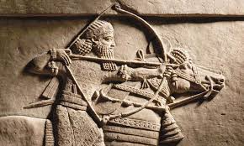
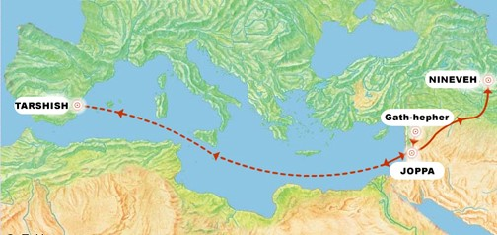
Chapter 1: Disobedient Jonah.

Slide 10
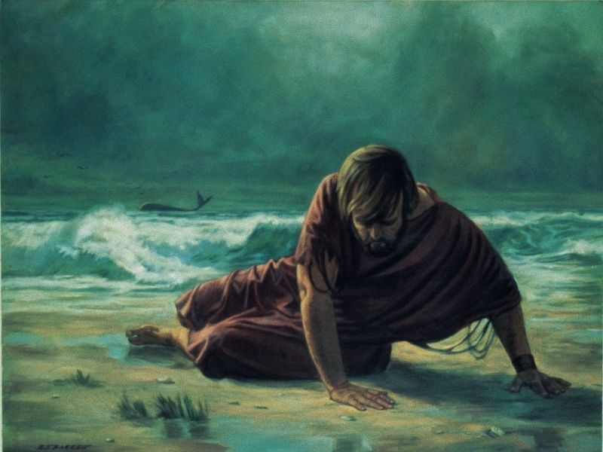
Chapter 2: Desperate Jonah.

Slide 11
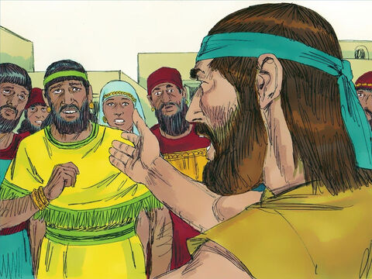
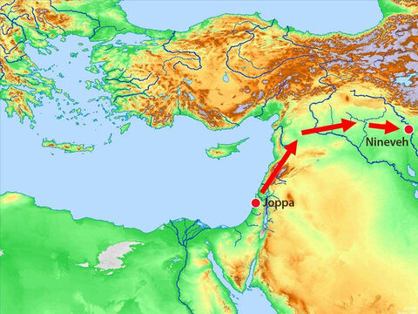
Chapter 3: Second Chance Jonah.

Slide 12
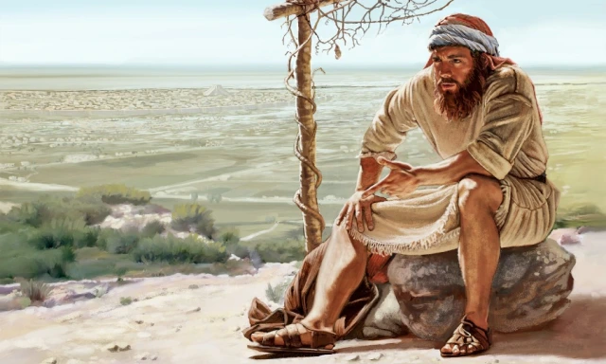
Chapter 4: Angry self-absorbed Jonah.

Slide 13
Implied- Chapter 5: Humble, repentant, surrendered Jonah.

Slide 14
Implied- Chapter 5: Humble, repentant, surrendered Jonah.
The fact that Jonah returned and then recorded the Book of Jonah for all to read and reflect upon, implies:
“The Word of the Lord came a third time to Jonah, “Record your life lesson of my scandalous love for all people, including your enemies, so those who take it to heart can reveal my heart.” And Jonah obeyed the Lord’s command.”

Slide 15
How do you respond to God’s outrageous scandalous love for your enemies?

Slide 16
Looking Back Living Forward
John 3:16,17.
Romans 3:9-18 Verse 9 “…are we any better? No not at all! We have already made the charge that Jews and Gentiles alike are all under sin.”
Rom 10:9-15.
2 Cor 5:11-21.
Mt 5:43-48 - Jesus Command to express His heart.

Slide 17
Looking Back Living Forward
Mt 5:43-48 - Jesus Command to reveal His heart.
“You have heard that it was said, ‘Love your neighbour and hate your enemy.’ But I tell you, love your enemies and pray for those who persecute you, that you may be children of your Father in heaven. He causes his sun to rise on the evil and the good, and sends rain on the righteous and the unrighteous. If you love those who love you, what reward will you get? Are not even the tax collectors doing that? And if you greet only your own people, what are you doing more than others? Do not even pagans do that? Be perfect, therefore, as your heavenly Father is perfect.”

Slide 18
Looking Back Living Forward
Mt 5:43-48 - Jesus Command to reveal His heart.
“You have heard that it was said, ‘Love your neighbour and hate your enemy.’ But I tell you, love your enemies and pray for those who persecute you, that you may be children of your Father in heaven. He causes his sun to rise on the evil and the good, and sends rain on the righteous and the unrighteous. If you love those who love you, what reward will you get? Are not even the tax collectors doing that? And if you greet only your own people, what are you doing more than others? Do not even pagans do that? Be perfect, therefore, as your heavenly Father is perfect.”
DOING obedient actions leads to BEING transformed in the heart.

Slide 19
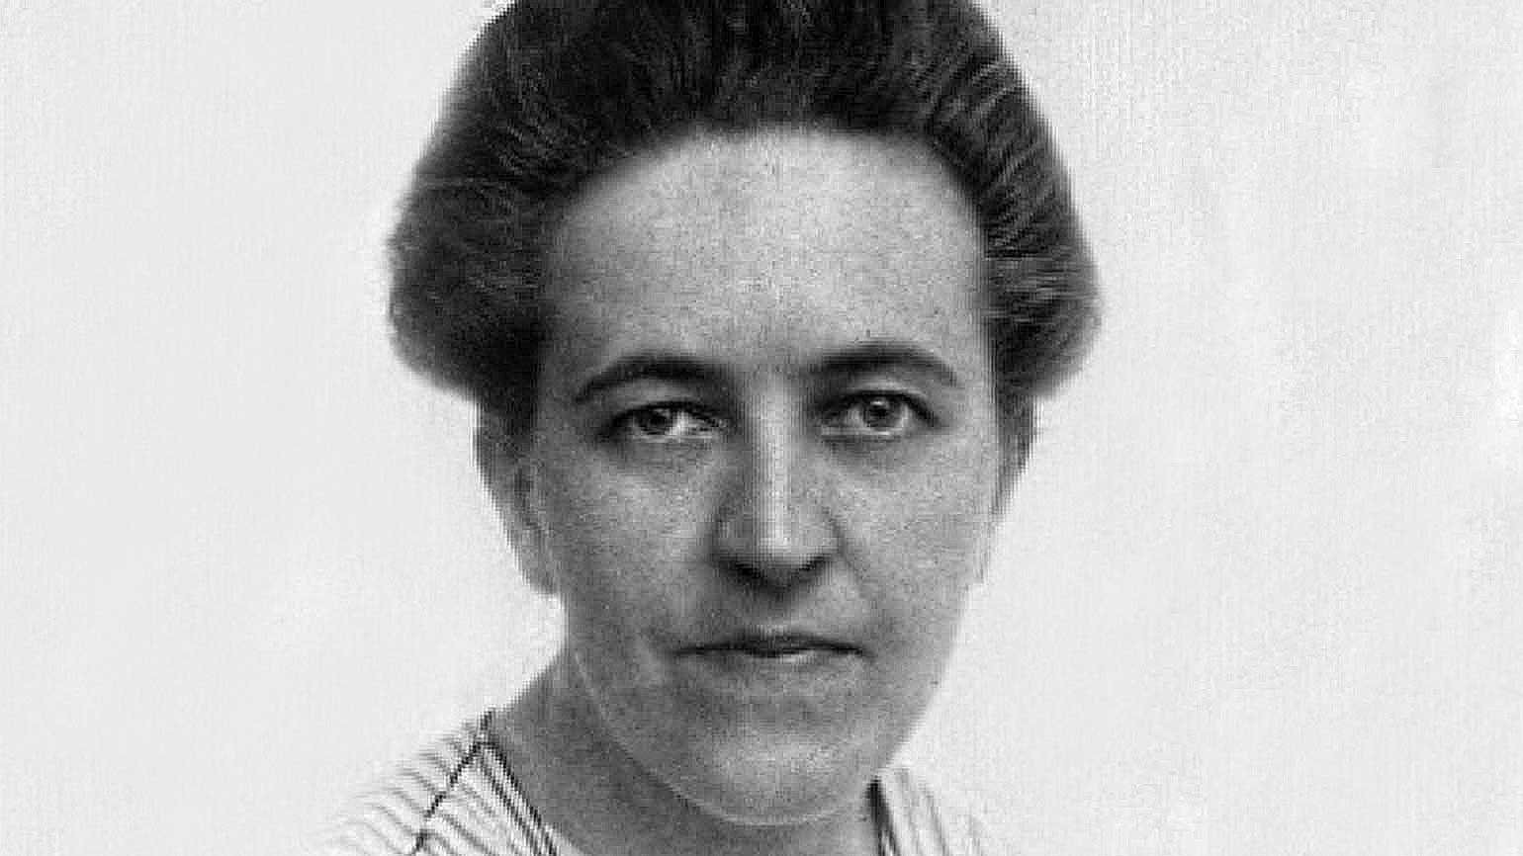
Looking Back Living Forward
The Transforming power of God’s Outrageous Love
Mt 5:43-48 - Jesus own heart.
Corrie Ten Boom – Ambassador of God
- Daughter of her Father in Heaven.

Slide 20
How will you respond to God’s outrageous scandalous love for your enemies?
I can’t. But God can. So I will.
Be the scandal, as sons and daughters of your Father in heaven, in surrender to Jesus.

